Slide 1
Binary Search Trees
Inorder traversal – the left child is recursively visited, the node is visited, and the right child is recursively visited.
Preorder traversal – a node is visited and then its children are visited recursively.
Postorder traversal – a node is visited after both children are visited.

Slide 2
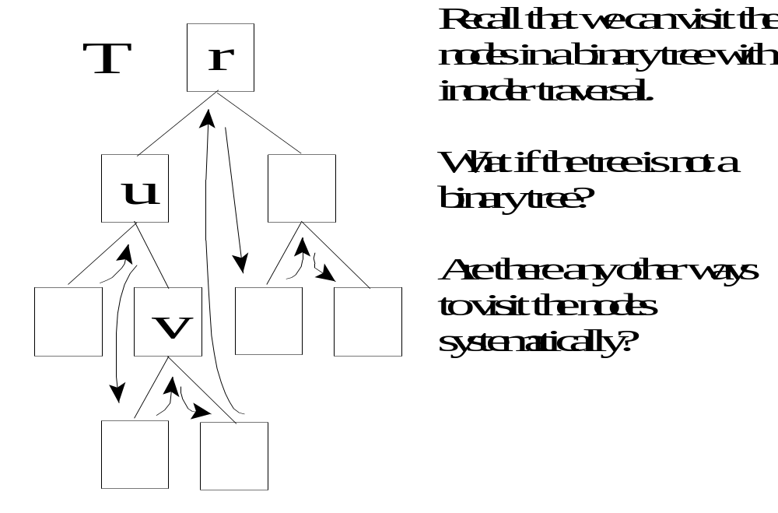
Preorder Traversal

Slide 3
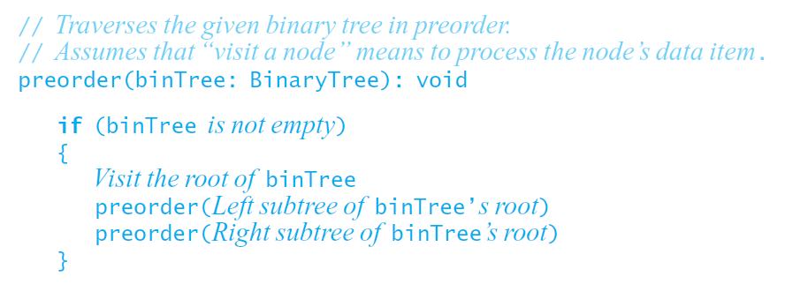
Traversals of a Binary Tree
Preorder traversal.
Data Structures and Problem Solving with C++: Walls and Mirrors, Carrano and Henry, © 2013

Slide 4
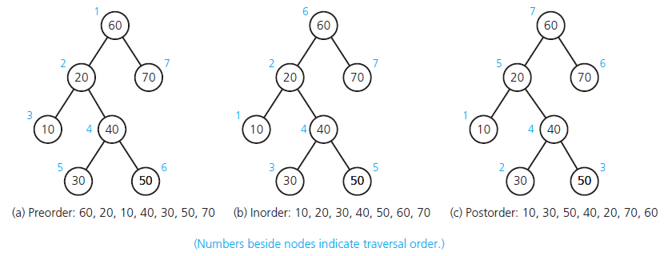
Traversals of a Binary Tree
FIGURE 15-11 Three traversals of a binary tree
Data Structures and Problem Solving with C++: Walls and Mirrors, Carrano and Henry, © 2013

Slide 5
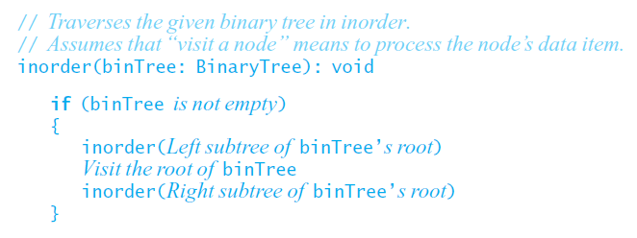
Traversals of a Binary Tree
Inorder traversal.
Data Structures and Problem Solving with C++: Walls and Mirrors, Carrano and Henry, © 2013

Slide 6
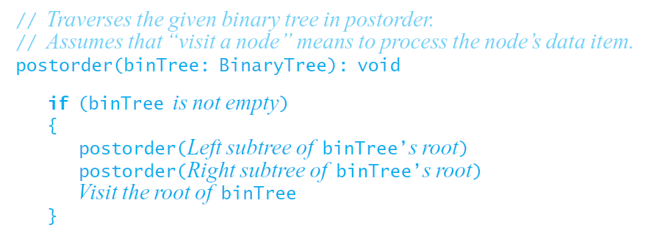
Traversals of a Binary Tree
Postorder traversal.
Data Structures and Problem Solving with C++: Walls and Mirrors, Carrano and Henry, © 2013

Slide 7
Binary Tree Operations
Test whether a binary tree is empty.
Get the height of a binary tree.
Get the number of nodes in a binary tree.
Get the data in a binary tree’s root.
Set the data in a binary tree’s root.
Add a new node containing a given data item to a binary tree.
Data Structures and Problem Solving with C++: Walls and Mirrors, Carrano and Henry, © 2013

Slide 8
Binary Tree Operations
Remove the node containing a given data item from a binary tree.
Remove all nodes from a binary tree.
Retrieve a specific entry in a binary tree.
Test whether a binary tree contains a specific entry.
Traverse the nodes in a binary tree in preorder, inorder, or postorder.
Data Structures and Problem Solving with C++: Walls and Mirrors, Carrano and Henry, © 2013

Slide 9
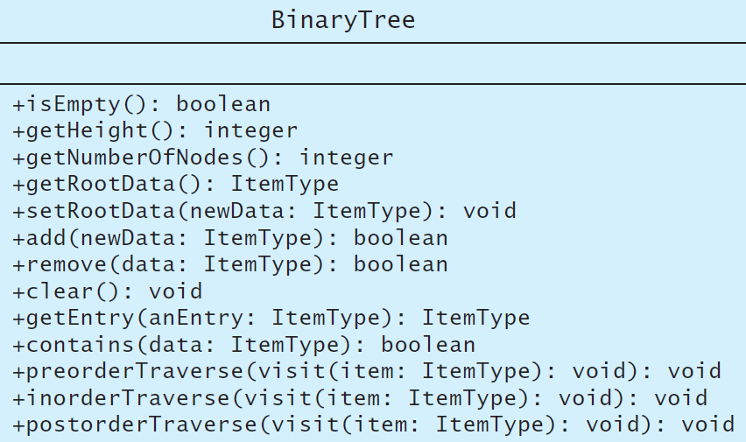
Binary Tree Operations
FIGURE 15-12 UML diagram for the class BinaryTree
Data Structures and Problem Solving with C++: Walls and Mirrors, Carrano and Henry, © 2013

Slide 10
Binary Tree Operations
Formalized specifications demonstrated in interface template for binary tree
  Listing 15-1
Note method names matching UML diagram
  Figure 15-12
.htm code listing files must be in the same folder as the .ppt files for these links to work
Data Structures and Problem Solving with C++: Walls and Mirrors, Carrano and Henry, © 2013

Slide 11
The ADT Binary Search Tree
ADT binary tree ill suited for search for specific item
Binary search tree solves problem
Properties of each node, n
  n ’s value greater than all values in left subtree T_{L}
  n ’s value less than all values in right subtree T_{R}
  Both T_{R} and T_{L} are binary search trees.
Data Structures and Problem Solving with C++: Walls and Mirrors, Carrano and Henry, © 2013

Slide 12
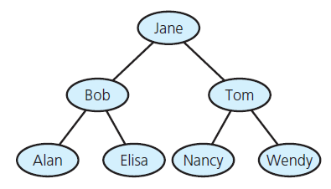
The ADT Binary Search Tree
FIGURE 15-13 A binary search tree of names
Data Structures and Problem Solving with C++: Walls and Mirrors, Carrano and Henry, © 2013

Slide 13
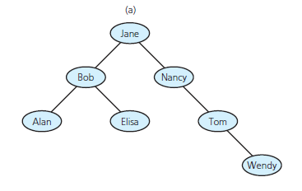
The ADT Binary Search Tree
FIGURE 15-14 Binary search trees
with the same data as in Figure 15-13
Data Structures and Problem Solving with C++: Walls and Mirrors, Carrano and Henry, © 2013

Slide 14
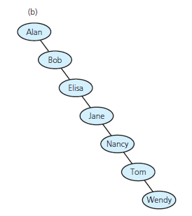
The ADT Binary Search Tree
FIGURE 15-14 Binary search trees
with the same data as in Figure 15-13
Data Structures and Problem Solving with C++: Walls and Mirrors, Carrano and Henry, © 2013

Slide 15
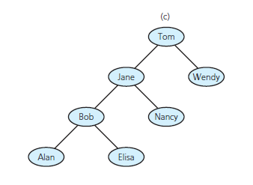
The ADT Binary Search Tree
FIGURE 15-14 Binary search trees
with the same data as in Figure 15-13
Data Structures and Problem Solving with C++: Walls and Mirrors, Carrano and Henry, © 2013

Slide 16
Binary Search Tree Operations
Test whether binary search tree is empty.
Get height of binary search tree.
Get number of nodes in binary search tree.
Get data in binary search tree’s root.
Insert new item into binary search tree.
Remove given item from binary search tree.
Data Structures and Problem Solving with C++: Walls and Mirrors, Carrano and Henry, © 2013

Slide 17
Binary Search Tree Operations
Remove all entries from binary search tree.
Retrieve given item from binary search tree.
Test whether binary search tree contains specific entry.
Traverse items in binary search tree in
  Preorder
  Inorder
  Postorder.
Data Structures and Problem Solving with C++: Walls and Mirrors, Carrano and Henry, © 2013

Slide 18
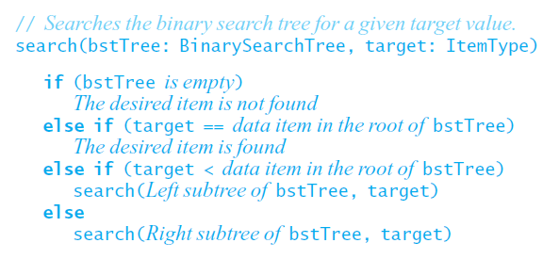
Searching a Binary Search Tree
Search algorithm for binary search tree
Data Structures and Problem Solving with C++: Walls and Mirrors, Carrano and Henry, © 2013

Slide 19
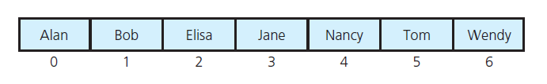
Searching a Binary Search Tree
FIGURE 15-15 An array of names in sorted order
Data Structures and Problem Solving with C++: Walls and Mirrors, Carrano and Henry, © 2013

Slide 20
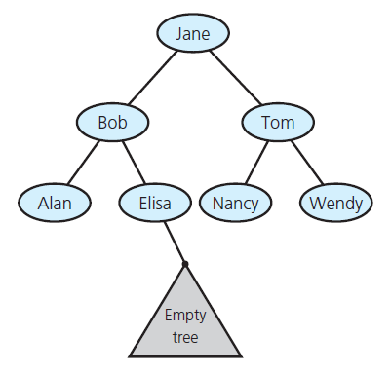
Creating a Binary Search Tree
FIGURE 15-16 Empty subtree where the search algorithm terminates when looking for Frank
Data Structures and Problem Solving with C++: Walls and Mirrors, Carrano and Henry, © 2013

Slide 21

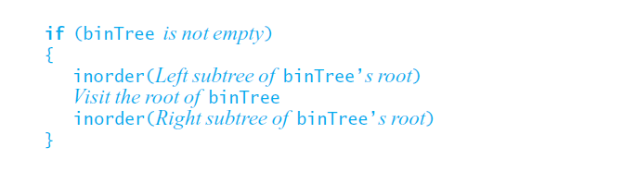
Traversals of a Binary Search Tree
Algorithm
Data Structures and Problem Solving with C++: Walls and Mirrors, Carrano and Henry, © 2013

Slide 22
Binary Trees
Recursive definition
  An empty tree is a binary tree
  A node with two child subtrees is a binary tree
  Only what you get from 1 by a finite number of applications of 2 is a binary tree.
Is this a binary tree?
56
26
200
18
28
190
213
12
24
27
Comp 122, Spring 2004

Slide 23
Binary Search Trees
View today as data structures that can support
dynamic set operations.
  Search, Minimum, Maximum, Predecessor, Successor, Insert, and Delete.
Can be used to build
  Dictionaries.
  Priority Queues.
Basic operations take time proportional to the height of the tree – O(h).
Comp 122, Spring 2004

Slide 24
BST – Representation
Represented by a linked data structure of nodes.
root(T) points to the root of tree T.
Each node contains fields:
  key
  left – pointer to left child: root of left subtree.
  right – pointer to right child : root of right subtree.
  p – pointer to parent. p[root[T]] = NIL (optional).
Comp 122, Spring 2004

Slide 25
Binary Search Tree Property
Stored keys must satisfy the binary search tree property.
  ∀ y in left subtree of x, then key[y] ≤ key[x].
  ∀ y in right subtree of x, then key[y] ≥ key[x].
56
26
200
18
28
190
213
12
24
27
Comp 122, Spring 2004

Slide 26
Inorder Traversal
The binary-search-tree property allows the keys of a binary search tree to be printed, in (monotonically increasing) order, recursively.
Inorder-Tree-Walk (x)
1. if x ≠ NIL
2. then Inorder-Tree-Walk(left[p])
3. print key[x]
4. Inorder-Tree-Walk(right[p])
56
26
200
18
28
190
213
12
24
27
How long does the walk take?
Can you prove its correctness?
Comp 122, Spring 2004

Slide 27
Correctness of Inorder-Walk
Must prove that it prints all elements, in order, and that it terminates.
By induction on size of tree. Size=0: Easy.
Size >1:
  Prints left subtree in order by induction.
  Prints root, which comes after all elements in left subtree (still in order).
  Prints right subtree in order (all elements come after root, so still in order).
Comp 122, Spring 2004

Slide 28
Querying a Binary Search Tree
All dynamic-set search operations can be supported in O(h) time.
h = Θ(lg n) for a balanced binary tree (and for an average tree built by adding nodes in random order.)
h = Θ(n) for an unbalanced tree that resembles a linear chain of n nodes in the worst case.
Comp 122, Spring 2004

Slide 29
Tree Search
Tree-Search(x, k)
1. if x = NIL or k = key[x]
2. then return x
3. if k < key[x]
4. then return Tree-Search(left[x], k)
5. else return Tree-Search(right[x], k)
56
26
200
Running time: O(h)
Aside: tail-recursion
18
28
190
213
12
24
27
Comp 122, Spring 2004

Slide 30
Iterative Tree Search
Iterative-Tree-Search(x, k)
1. while x ≠ NIL and k ≠ key[x]
2. do if k < key[x]
3. then x ← left[x]
4. else x ← right[x]
5. return x
56
26
200
18
28
190
213
12
24
27
The iterative tree search is more efficient on most computers.
The recursive tree search is more straightforward.
Comp 122, Spring 2004

Slide 31
Finding Min & Max
The binary-search-tree property guarantees that:
  The minimum is located at the left-most node.
  The maximum is located at the right-most node.
Tree-Minimum(x) Tree-Maximum(x)
1. while left[x] ≠ NIL 1. while right[x] ≠ NIL
2. do x ← left[x] 2. do x ← right[x]
3. return x 3. return x
Q: How long do they take?
Comp 122, Spring 2004

Slide 32
Predecessor and Successor
Successor of node x is the node y such that key[y] is the smallest key greater than key[x].
The successor of the largest key is NIL.
Search consists of two cases.
  If node x has a non-empty right subtree, then x’s successor is the minimum in the right subtree of x.
  If node x has an empty right subtree, then:
    As long as we move to the left up the tree (move up through right children), we are visiting smaller keys.
    x’s successor y is the node that x is the predecessor of (x is the maximum in y’s left subtree).
    In other words, x’s successor y, is the lowest ancestor of x whose left child is also an ancestor of x.
Comp 122, Spring 2004

Slide 33
Pseudo-code for Successor
Tree-Successor(x)
if right[x] ≠ NIL
2. then return Tree-Minimum(right[x])
3. y ← p[x]
4. while y ≠ NIL and x = right[y]
5. do x ← y
6. y ← p[y]
7. return y
56
26
200
Code for predecessor is symmetric.
Running time: O(h)
18
28
190
213
12
24
27
Comp 122, Spring 2004

Slide 34
BST Insertion – Pseudocode
Change the dynamic set represented by a BST.
Ensure the binary-search-tree property holds after change.
Insertion is easier than deletion.
Tree-Insert(T, z)
y ← NIL
x ← root[T]
while x ≠ NIL
do y ← x
if key[z] < key[x]
then x ← left[x]
else x ← right[x]
p[z] ← y
if y = NIL
then root[t] ← z
else if key[z] < key[y]
then left[y] ← z
else right[y] ← z
56
26
200
18
28
190
213
12
24
27
Comp 122, Spring 2004

Slide 35
Analysis of Insertion
Initialization: O(1)
While loop in lines 3-7 searches for place to insert z, maintaining parent y.
This takes O(h) time.
Lines 8-13 insert the value: O(1)
⇒ TOTAL: O(h) time to insert a node.
Tree-Insert(T, z)
y ← NIL
x ← root[T]
while x ≠ NIL
do y ← x
if key[z] < key[x]
then x ← left[x]
else x ← right[x]
p[z] ← y
if y = NIL
then root[t] ← z
else if key[z] < key[y]
then left[y] ← z
else right[y] ← z
Comp 122, Spring 2004

Slide 36
Exercise: Sorting Using BSTs
Sort (A)
for i ← 1 to n
do tree-insert(A[i])
inorder-tree-walk(root)
  What are the worst case and best case running times?
  In practice, how would this compare to other sorting algorithms?
Comp 122, Spring 2004

Slide 37
Tree-Delete (T, x)
if x has no children ♦ case 0
then remove x
if x has one child ♦ case 1
then make p[x] point to child
if x has two children (subtrees) ♦ case 2
then swap x with its successor
perform case 0 or case 1 to delete it
⇒ TOTAL: O(h) time to delete a node
Comp 122, Spring 2004

Slide 38
Deletion – Pseudocode
Tree-Delete(T, z)
/* Determine which node to splice out: either z or z’s successor. */
if left[z] = NIL or right[z] = NIL
then y ← z
else y ← Tree-Successor[z]
/* Set x to a non-NIL child of x, or to NIL if y has no children. */
if left[y] ≠ NIL
then x ← left[y]
else x ← right[y]
/* y is removed from the tree by manipulating pointers of p[y] and x */
if x ≠ NIL
then p[x] ← p[y]
/* Continued on next slide */
Comp 122, Spring 2004

Slide 39
Deletion – Pseudocode
Tree-Delete(T, z) (Contd. from previous slide)
if p[y] = NIL
then root[T] ← x
else if y ← left[p[i]]
then left[p[y]] ← x
else right[p[y]] ← x
/* If z’s successor was spliced out, copy its data into z */
if y ≠ z
then key[z] ← key[y]
copy y’s satellite data into z.
return y
Comp 122, Spring 2004

Slide 40
Binary Search Tree
Dictionary Data Structure
Binary tree property
  each node has ≤ 2 children
  result:
    storage is small
    operations are simple
    average depth is small
Search tree property
  all keys in left subtree smaller than root’s key
  all keys in right subtree larger than root’s key
  result:
    easy to find any given key
    Insert/delete by changing links
8
5
11
2
6
10
12
4
7
9
14
13
Notes:
A binary search tree is a binary tree in which all nodes in the left subtree of a node have lower values than the node. All nodes in the right subtree of a node have higher value than the node.
It’s like making that recursion into the data structure!
I’m storing integers at each node. Does everybody think that’s what I’m _really_ going to store?
What do I need to know about what I store?
(comparison, equality testing)

Slide 41
Example and Counter-Example
8
5
5
11
4
8
2
7
6
10
18
1
7
11
4
15
20
3
NOT A
BINARY SEARCH TREE
BINARY SEARCH TREE
21
Notes:
Why is the one on the left a BST? It’s not complete!
(B/c BSTs don’t need to be complete)
Why isn’t the one on the right a BST?
Three children of 5
20 has a left child larger than it.
What’s wrong with 11?
Even though 15 isn’t a direct child, it _still_ needs to be less than 11!

Slide 42
Complete Binary Search Tree
Complete binary search tree
(aka binary heap):
  Links are completely filled, except possibly bottom level, which is filled left-to-right.
8
5
15
3
7
9
17
1
4
6

Slide 43
In-Order Traversal
10
visit left subtree
visit node
visit right subtree
What does this guarantee with a BST?
5
15
2
9
20
7
17
30
In order listing:
2→5→7→9→10→15→17→20→30
Notes:
Anyone notice anything interesting about that in-order listing?
Everything in the left subtree is listed first. Then the root. Then everything in the right subtree.
OK, let’s work out the code to make the in-order listing.
Is there an iterative version that doesn’t use its own stack?
Not really, no. So, recursion is probably OK here. Anyway, if the tree’s too deep for recursion, you must have a huge amount of data.
If (n != null)
inorder(n->left)
cout << n
inorder(n->right)

Slide 44
Recursive Find
10
Node *
find(Comparable key, Node * t)
{
if (t == NULL) return t;
else if (key < t->key)
return find(key, t->left);
else if (key > t->key)
return find(key, t->right);
else
return t;
}
5
15
2
9
20
7
17
30
Runtime:
  Best-worse case?
  Worst-worse case?
  f(depth)?
Binary Search Trees
CSE 326 Autumn 2001 <number>
Notes:
Now, let’s try finding a node.
Find 9.
This time I’ll supply the code.
This should look a _lot_ like binary search!
How long does it take?
Log n is an easy answer, but what if the tree is very lopsided?
So really, this is worst case O(n)!
A better answer is theta of the depth of the node sought.
If we can bound the depth of that node, we can bound the length of time a search takes.

Slide 45
Iterative Find
10
Node *
find(Comparable key, Node * t)
{
while (t != NULL && t->key != key)
{
if (key < t->key)
t = t->left;
else
t = t->right;
}
return t;
}
5
15
2
9
20
7
17
30

Slide 46
Insert
Concept:
  Proceed down tree as in Find
  If new key not found, then insert a new node at last spot traversed
void
insert(Comparable x, Node * t)
{
if ( t == NULL ) {
t = new Node(x);
} else if (x < t->key) {
insert( x, t->left );
} else if (x > t->key) {
insert( x, t->right );
} else {
// duplicate
// handling is app-dependent
}
Binary Search Trees
CSE 326 Autumn 2001 <number>
Notes:
Now, let’s try finding a node.
Find 9.
This time I’ll supply the code.
This should look a _lot_ like binary search!
How long does it take?
Log n is an easy answer, but what if the tree is very lopsided?
So really, this is worst case O(n)!
A better answer is theta of the depth of the node sought.
If we can bound the depth of that node, we can bound the length of time a search takes.

Slide 47
BuildTree for BSTs
Suppose the data 1, 2, 3, 4, 5, 6, 7, 8, 9 is inserted into an initially empty BST:
  in order
  in reverse order
  median first, then left median, right median, etc.
Notes:
OK, let’s buildTree. How long does this take?
Well, IT DEPENDS!
Let’s say we want to build a tree from 123456789
What happens if we insert in order?
Reverse order?
What about 5, then 3, then 7, then 2, then 1, then 6, then 8, then 9?

Slide 48
Analysis of BuildTree
Worst case is O(n²)
  1 + 2 + 3 + … + n = O(n²)
Average case assuming all orderings equally likely:
  O(n log n)
  averaging over all insert sequences (not over all binary trees)
  equivalently: average depth of a node is log n
  proof: see Introduction to Algorithms, Cormen, Leiserson, & Rivest
Binary Search Trees
CSE 326 Autumn 2001 <number>
Notes:
Average runtime is equal to the average depth of a node in the tree.
We’ll calculate the average depth by finding the sum of all depths in the tree, and dividing by the number of nodes.
What’s the sum of all depths?
D(n) = D(I) + D(N - I - 1) + N - 1
(left subtree = I, root is 1 node, so right = n - I - 1. D(I) is depth of left, 1 node deeper in overall, same goes for right, total of I + N - I - 1 extra depth).
For BSTs, all subtree sizes are equally likely (because we pick the middle element and random and the rest fall on the left or right deterministically).
Each subtree then averages 1/N * sum 0 to N-1 of D(j)

Slide 49
BST Bonus:
FindMin, FindMax
Find minimum
Find maximum
10
5
15
2
9
20
7
17
30

Slide 50
Successor Node
Next larger node
in this node’s subtree
10
Node * succ(Node * t) {
if (t->right == NULL)
return NULL;
else
return min(t->right);
}
5
15
2
9
20
7
17
30
How many children can the successor of a node have?
Binary Search Trees
CSE 326 Autumn 2001 <number>
Notes:
Here’s a little digression.
Maybe it’ll even have an application at some point.
Find the next larger node in 10’s subtree.
Can we define it in terms of min and max?
It’s the min of the right subtree!

Slide 51
Predecessor Node
Next smaller node
in this node’s subtree
10
Node * pred(Node * t) {
if (t->left == NULL)
return NULL;
else
return max(t->left);
}
5
15
2
9
20
7
17
30
Notes:
Predecessor is just the mirror problem.

Slide 52
Deletion
10
5
15
2
9
20
7
17
30
Why might deletion be harder than insertion?
Binary Search Trees
CSE 326 Autumn 2001 <number>
Notes:
And now for something completely different.
Let’s say I want to delete a node. Why might it be harder than insertion?
Might happen in the middle of the tree instead of at leaf.
Then, I have to fix the BST.

Slide 53
Lazy Deletion
Instead of physically deleting nodes, just mark them as deleted
  simpler
  physical deletions done in batches
  some adds just flip deleted flag
  extra memory for deleted flag
  many lazy deletions slow finds
  some operations may have to be modified (e.g., min and max)
10
5
15
2
9
20
7
17
30
Notes:
Now, before we move on to all the pains of true deletion, let’s do it the easy way.
We’ll just pretend we delete deleted nodes.
This has some real advantages:
…

Slide 54
Lazy Deletion
Delete(17)
Delete(15)
Delete(5)
Find(9)
Find(16)
Insert(5)
Find(17)
10
5
15
2
9
20
7
17
30
Binary Search Trees
CSE 326 Autumn 2001 <number>
Notes:
OK, let’s do some lazy deletions.
Everybody yawn, stretch, and say “Mmmm… doughnut” to get in the mood.
Those of you who are already asleep have the advantage.

Slide 55
Deletion - Leaf Case
Delete(17)
10
5
15
2
9
20
7
17
30
Binary Search Trees
CSE 326 Autumn 2001 <number>
Notes:
Alright, we did it the easy way, but what about real deletions?
Leaves are easy; we just prune them.

Slide 56
Deletion - One Child Case
Delete(15)
10
5
15
2
9
20
7
30
Binary Search Trees
CSE 326 Autumn 2001 <number>
Notes:
Single child nodes we remove and…
Do what?
We can just pull up their children.
Is the search tree property intact?
Yes.

Slide 57
Deletion - Two Child Case
Replace node with descendant whose value is guaranteed to be between left and right subtrees: the successor
10
5
20
2
9
30
Delete(5)
7
Could we have used predecessor instead?
Notes:
Ah, now the hard case.
How do we delete a two child node?
We remove it and replace it with what?
It has all these left and right children that need to be greater and less than the new value (respectively).
Is there any value that is guaranteed to be between the two subtrees?
Two of them: the successor and predecessor!
So, let’s just replace the node’s value with it’s successor and then delete the succ.

Slide 58
Delete Code
void delete(Comparable key, Node *& root) {
Node *& handle(find(key, root));
Node * toDelete = handle;
if (handle != NULL) {
if (handle->left == NULL) { // Leaf or one child
handle = handle->right;
delete toDelete;
} else if (handle->right == NULL) { // One child
handle = handle->left;
delete toDelete;
} else { // Two children
successor = succ(root);
handle->data = successor->data;
delete(successor->data, handle->right);
}
}
}
Binary Search Trees
CSE 326 Autumn 2001 <number>
Notes:
Here’s the code for deletion using lots of confusing reference pointers BUT no leaders, fake nodes.
The iterative version of this can get somewhat messy, but it’s not really any big deal.

Slide 59
Thinking about
Binary Search Trees
Observations
  Each operation views two new elements at a time
  Elements (even siblings) may be scattered in memory
  Binary search trees are fast if they’re shallow
Realities
  For large data sets, disk accesses dominate runtime
  Some deep and some shallow BSTs exist for any data
Binary Search Trees
CSE 326 Autumn 2001 <number>
Notes:
OK, let’s think about BSTs in the same way we thought about heaps.
Indeed, some of the same ideas come up.

Slide 60
Beauty is Only Θ(log n) Deep
Binary Search Trees are fast if they’re shallow:
  perfectly complete
  complete – possibly missing some “fringe” (leaves)
  any other good cases?
What matters?
  Problems occur when one branch is much longer than another
  i.e. when tree is out of balance
Binary Search Trees
CSE 326 Autumn 2001 <number>
Notes:
What makes a good BST good?
Here’s two examples. Are these the only good BSTs?
No!
Anything without too many long branches is good, right?

Slide 61
Dictionary Implementations
 | unsorted array | sorted array | linked list | BST
insert | O(n) | find + O(n) | O(1) | O(Depth)
find | O(n) | O(log n) | O(n) | O(Depth)
delete | find + O(1) (mark-as-deleted) | find + O(1) (mark-as-deleted) | find + O(1) | O(Depth)
BST’s looking good for shallow trees, i.e. if Depth is small (log n); otherwise as bad as a linked list!

